Slide 1
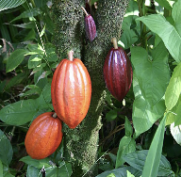
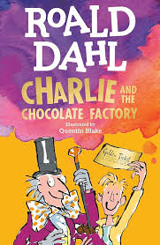


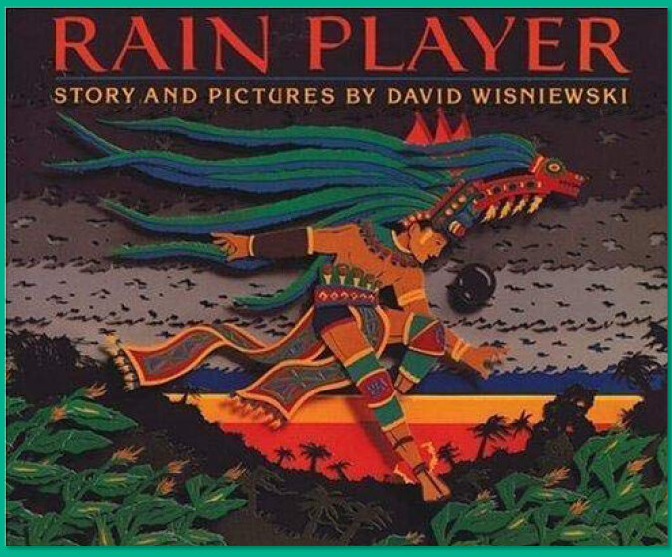
Summer Term 2025-26 - Curriculum Bulletin
Year 5 & 6 – Full of Beans
Mathematics
English
For Mathematics this term, Year 5 will be completing the topics of shape, position & direction, decimals, negative numbers and measurements.
For shape, they will learn to estimate, measure and draw angles up to 180 degrees. They will learn to calculate angles around a point and on a straight line. They will also learn to read and plot coordinates and to solve problems with coordinates. They will explore translation and reflection of shapes on a grid. The children will explore decimals by learning how to add and subtract numbers with different numbers of decimal places. They will also learn to multiply and divide by 10, 100 and 1000. Year 5 will also learn about negative numbers. They will order and compare negative numbers and calculate the difference between two numbers, including negative numbers. For measurement, the children will be learning how to convert between units such as millimetres and centimetres. They will also convert between metric and imperial units. The children will learn that volume is measured in cubic centimetres and will compare, estimate and calculate volume and capacity.
Year 6 will be learning about shape and position and direction. They will be learning to calculate angles that are vertically opposite. They will solve problems involving missing angles in triangles and quadrilaterals. The children will also explore nets of different 3D shapes. Year 6 will also learn to read and plot points across 4 quadrants and will solve problems involving coordinates. They will learn to translate and reflect shapes across four quadrants. On completion of these units, year 6 will consolidate their learning from across the year 6 curriculum.
Reading:
As part of our ’Steps to Read’ programme the children will be reading a range of texts on the theme of Reading Breadth-Literary Heritage, Plays & Poetry. The books will support the children to develop their word reading and comprehension skills as well as to increase their knowledge of a wider range of texts and themes.
As part of our ‘Take One Book’ programme, the children will be reading the book ‘Charlie and the Chocolate Factory’ by Roald Dahl. This will support their reading and comprehension skills over a longer text.
Writing:
This term, Year 5 and 6 children will be reading the book ‘Rain Player’ by David Wisniewski. The children will use the text to write a narrative and an explanation text. They will be developing their use of more sophisticated punctuation such as dashes, commas and brackets for parenthesis. This term, the children will also be ‘Writing for Pleasure’ to write a narrative and an explanation text linked to their own ideas an interests.

Slide 2
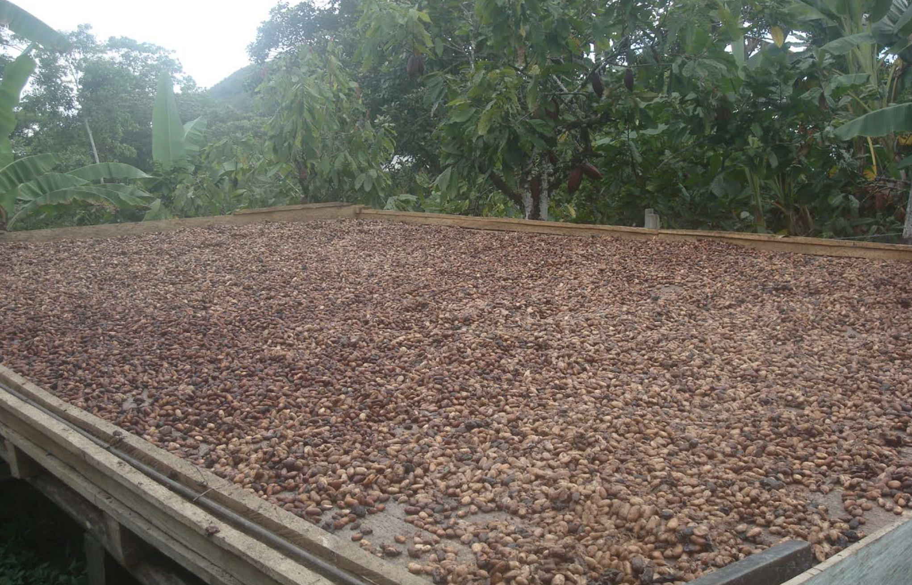

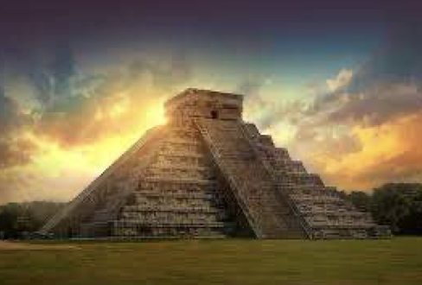

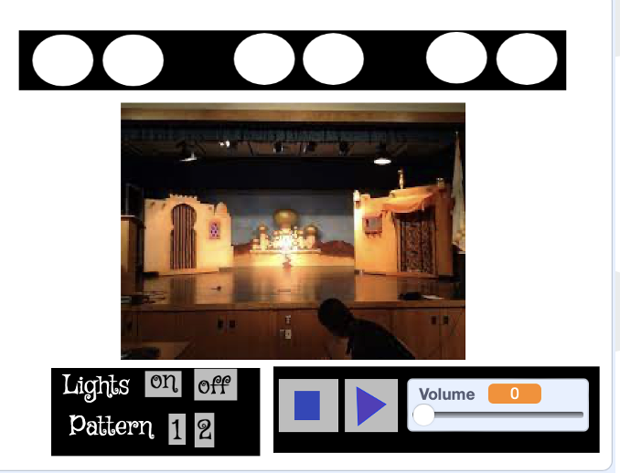
The Big Picture – Full of Beans
Summer Term 2025-26 - Curriculum Bulletin
History – The Mayans
Geography – Cocoa Bean Trade
For History, the children will be learning about the Mayan civilization. They will learn who the Mayans were, and where and when they lived. They will learn that the Mayans were a successful and advanced civilization and what caused them to disappear. The children will learn about the beliefs, rituals and lifestyle of the Ancient Maya including the football-like game, Pok-a-tok.
For Geography, the children will be exploring trade, in particular, the trade of chocolate. They will learn about how everyday products arrive in supermarkets and will be able to describe the chocolate supply chain. They will find out about the climate in South America where cocoa beans are grown. They will also consider how trade brings advantages and disadvantages to different people and about the concept of fair trade.
Computing
For Computing, the children will learn how to programme a ‘simulation of a physical system’. This will be achieved using the software ‘Scratch’. Pupils will work through the construction of a simulation audio and lighting system themed around our summer production of Oliver. They will predict, programme, test and debug their algorithms to achieve this.
Design and Technology – Chocolate bar Packaging
For D&T this term, Year 5 & 6 will become chocolatiers! They will be encouraged to use their creativity to design, brand and make packaging for their own design of chocolates. They will conduct market research to gain feedback on their designs. They will also make their own chocolates.
Art – Set Design
For Art, the children will learn that designers and makers design “sets” which form the backdrop/props to give context to drama (theatre, film or animation). They will apply skills across a range of disciplines including painting, making and drawing to create a mini-set themed around our summer production of Oliver. They children will consider scale, perspective and composition when creating their sets.

Slide 3

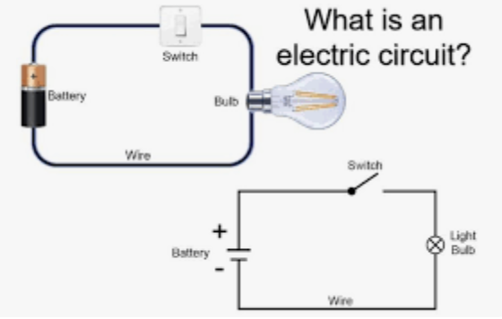

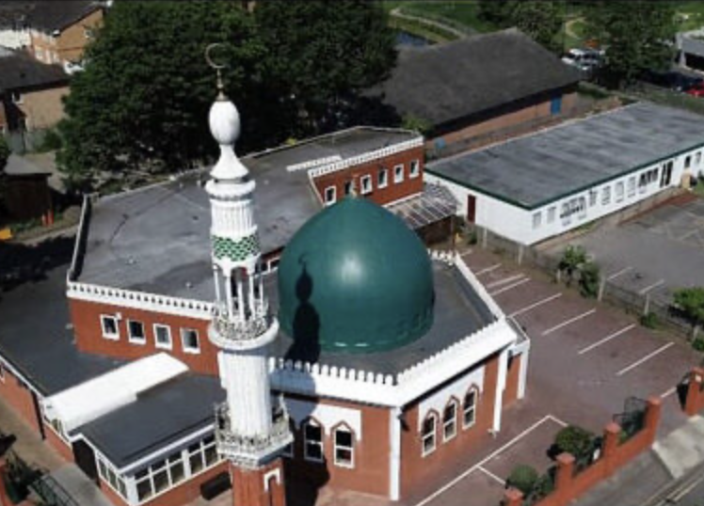
Summer Term 2025-26 - Curriculum Bulletin
Music
For Music this term, Year 5 and 6 will be learning to play the recorder. They will learn about the different parts of the recorder and compare to similar instruments played by the Ancient Mayans. The children will describe the sounds they can hear using musical terminology. The children will learn to play the notes B,A, G, C, D, E and F#. The children will learn to sing and play a simple tune using the notes learnt and compose their own songs inspired by the Mayan melody Xtoles.
Science
For Science this term, Year 5 and 6 will be learning about electricity and light. They will be building simple circuits to light a bulb and will investigate the effects of altering the number of batteries, number of bulbs and length of wire on the brightness of the bulb. The children will also learn about the properties of light and will be able to use the idea that light travels in straight lines to explain why shadows have the same shape as the objects that cast them.
Physical Education
For P.E. this term, the children will be practising skills across the sports of, tennis, cricket and dance.
The children will also be doing athletics, where they will practice running, jumping and throwing. They loo forward to demonstrating their skills at the end of term during sports day.
Religious Education
For RE this term, the children will be continued their learning about Islam. They will explore the question: How far does the Mosques contribute to the concept of Ummah?
To enrich this learning, the children will visit Maidenhead Mosque where they will observe the place of worship, practices and objects.
PSHE
For PSHE this term, we will be exploring the topic of ‘Families and People who care for Me’ In this unit they will learn about the importance of families for oneself and explain what their families means to them. They will describe the qualities of healthy family life and explain their role within their families. The children will learn about the characteristics of a healthy family life including respect for parents. They will develop a strong understanding of the promises and meaning of marriage, which is intended to be lifelong.

Slide 4
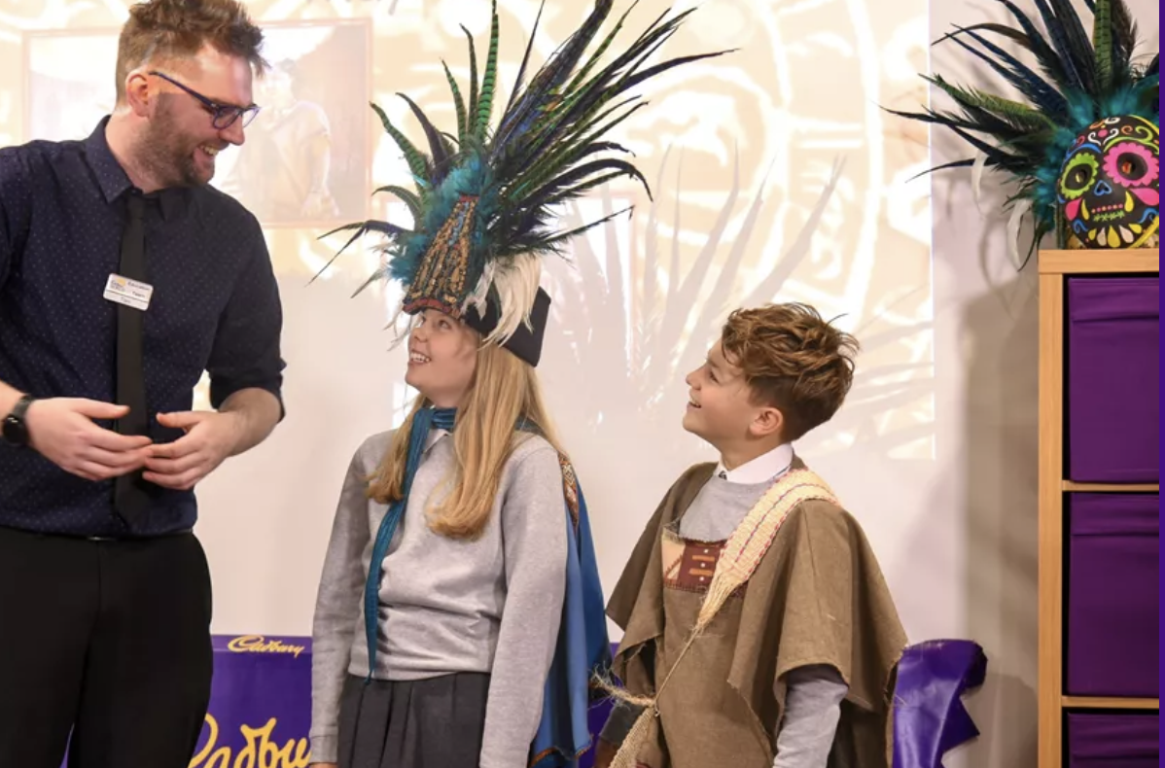
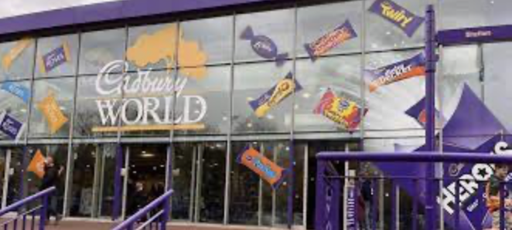
Summer Term 2025-26 - Curriculum Bulletin
Trips and enrichment
This term, we are delighted to be taking Year 5 & 6 to Cadburys World. Here they will see the delights of the factory and learn the history of the Cadbury chocolate brand. The children will also take part in an educational talk about the Ancient Maya. This workshop will bring our topic to life! The children will be introduced to the great city of Chichen Itza and will discover the Mayan myths and legends that claimed how humans were created.
The children will have the opportunity to see real cocoa pods filled with the cocoa beans that were so valuable to Mayans in c. CE 900, and the wooden whisk they used to make their favourite chocolate drink. Lucky pupils will even have the chance to dress as a Mayan!

