Slide 1
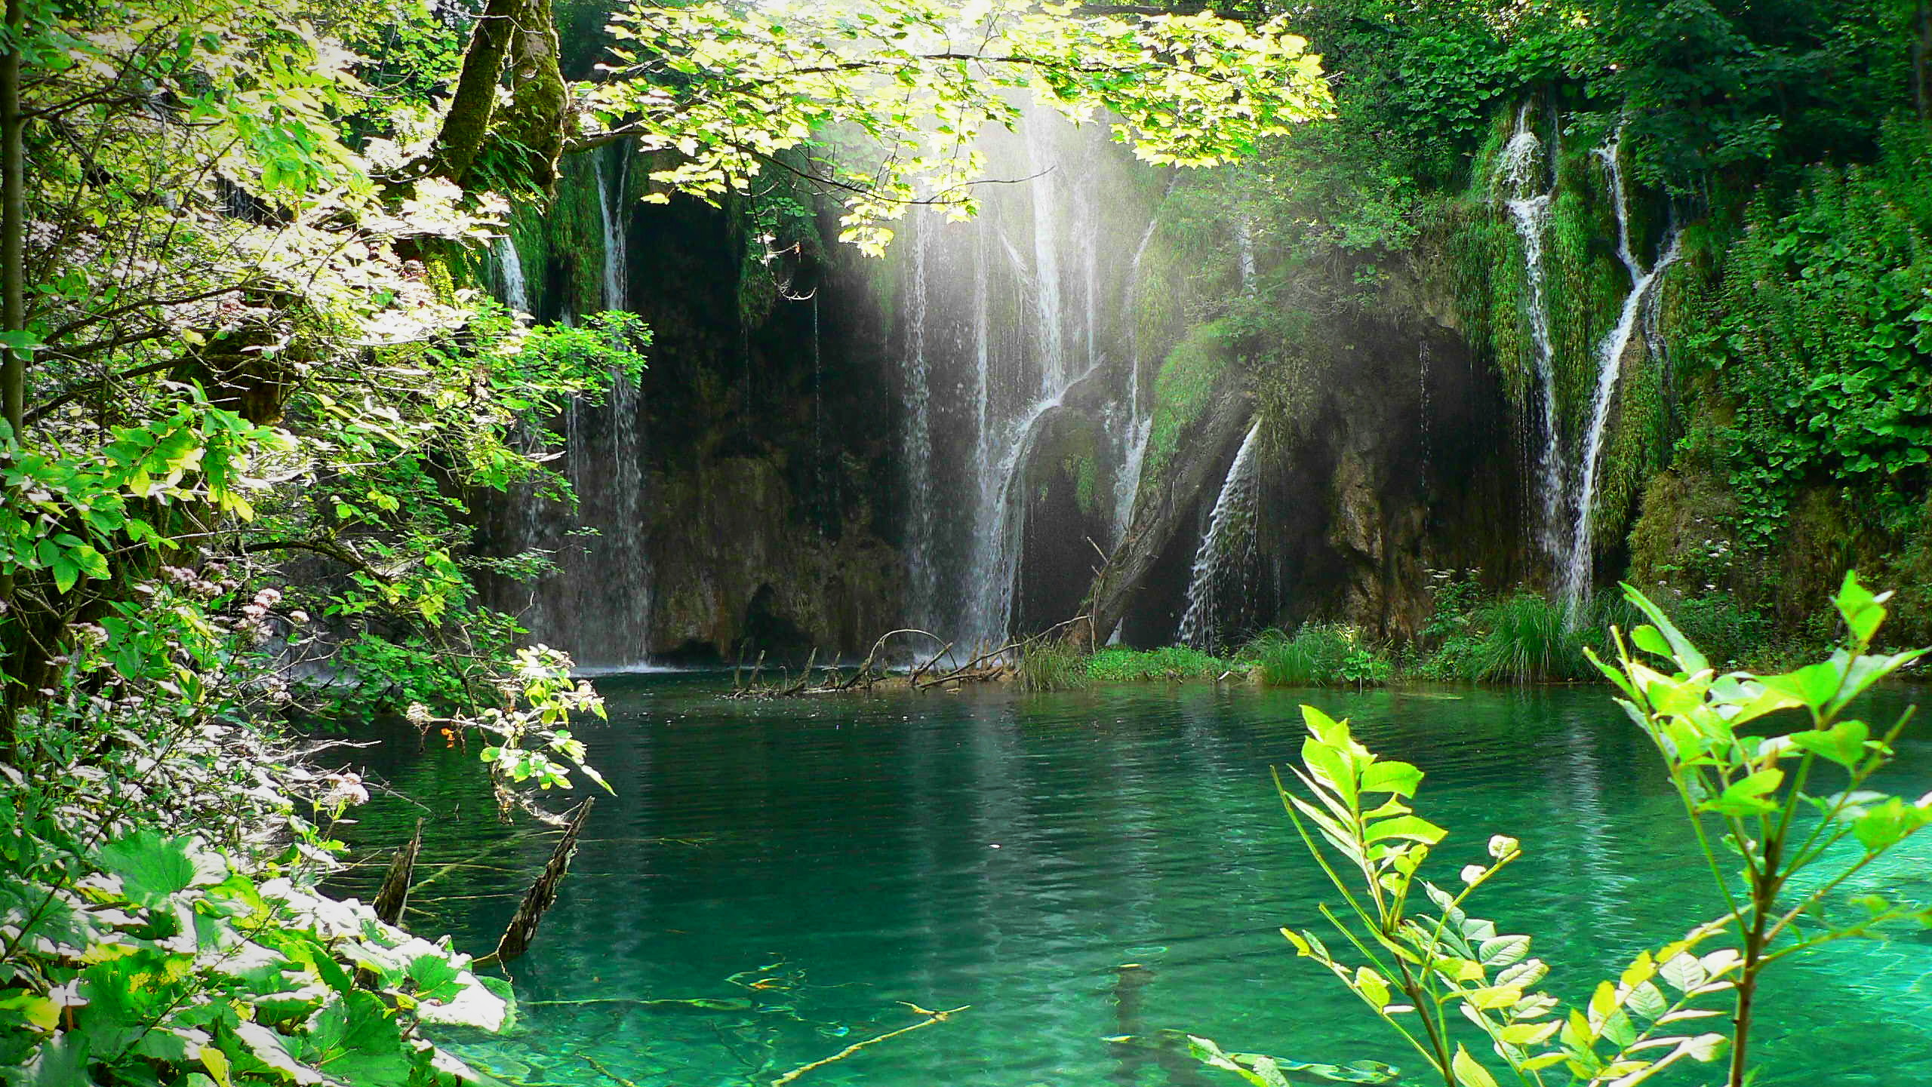
Green Christmas
How can we give animals a better Christmas?

Slide 2
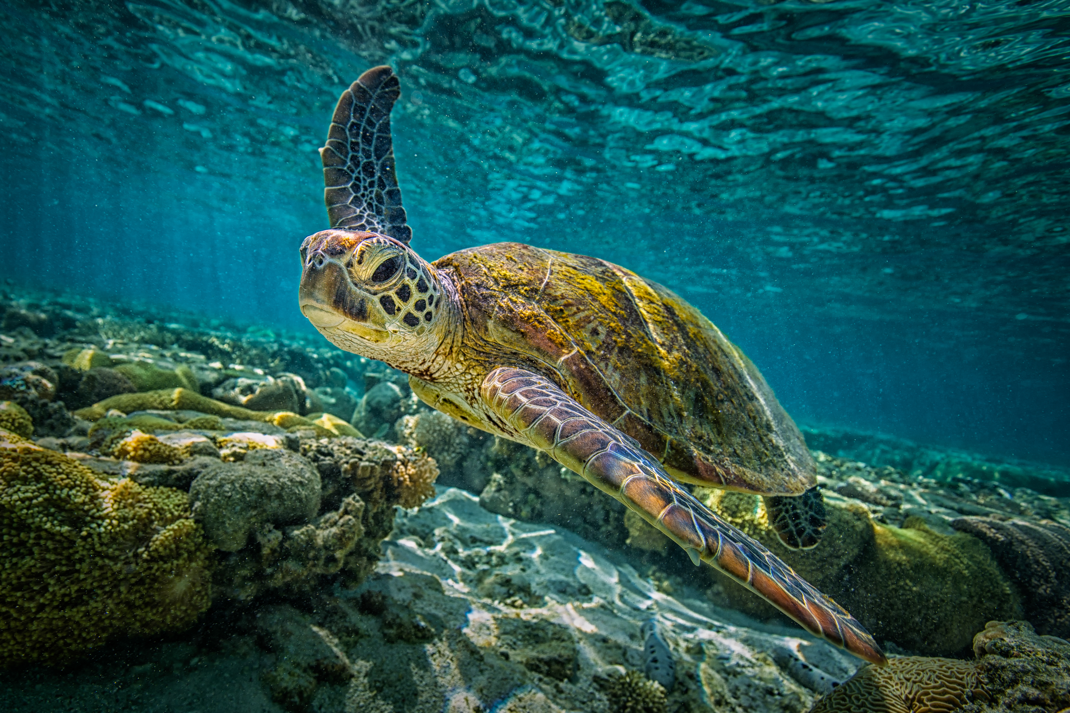
What can we do?
Millions of people every year will drop litter and waste loooooooooooooots of pieces of paper. Its making loads of animals like the ones here lose their homes and food. They need a proper home and that’s where the super heroes come in!

Slide 3
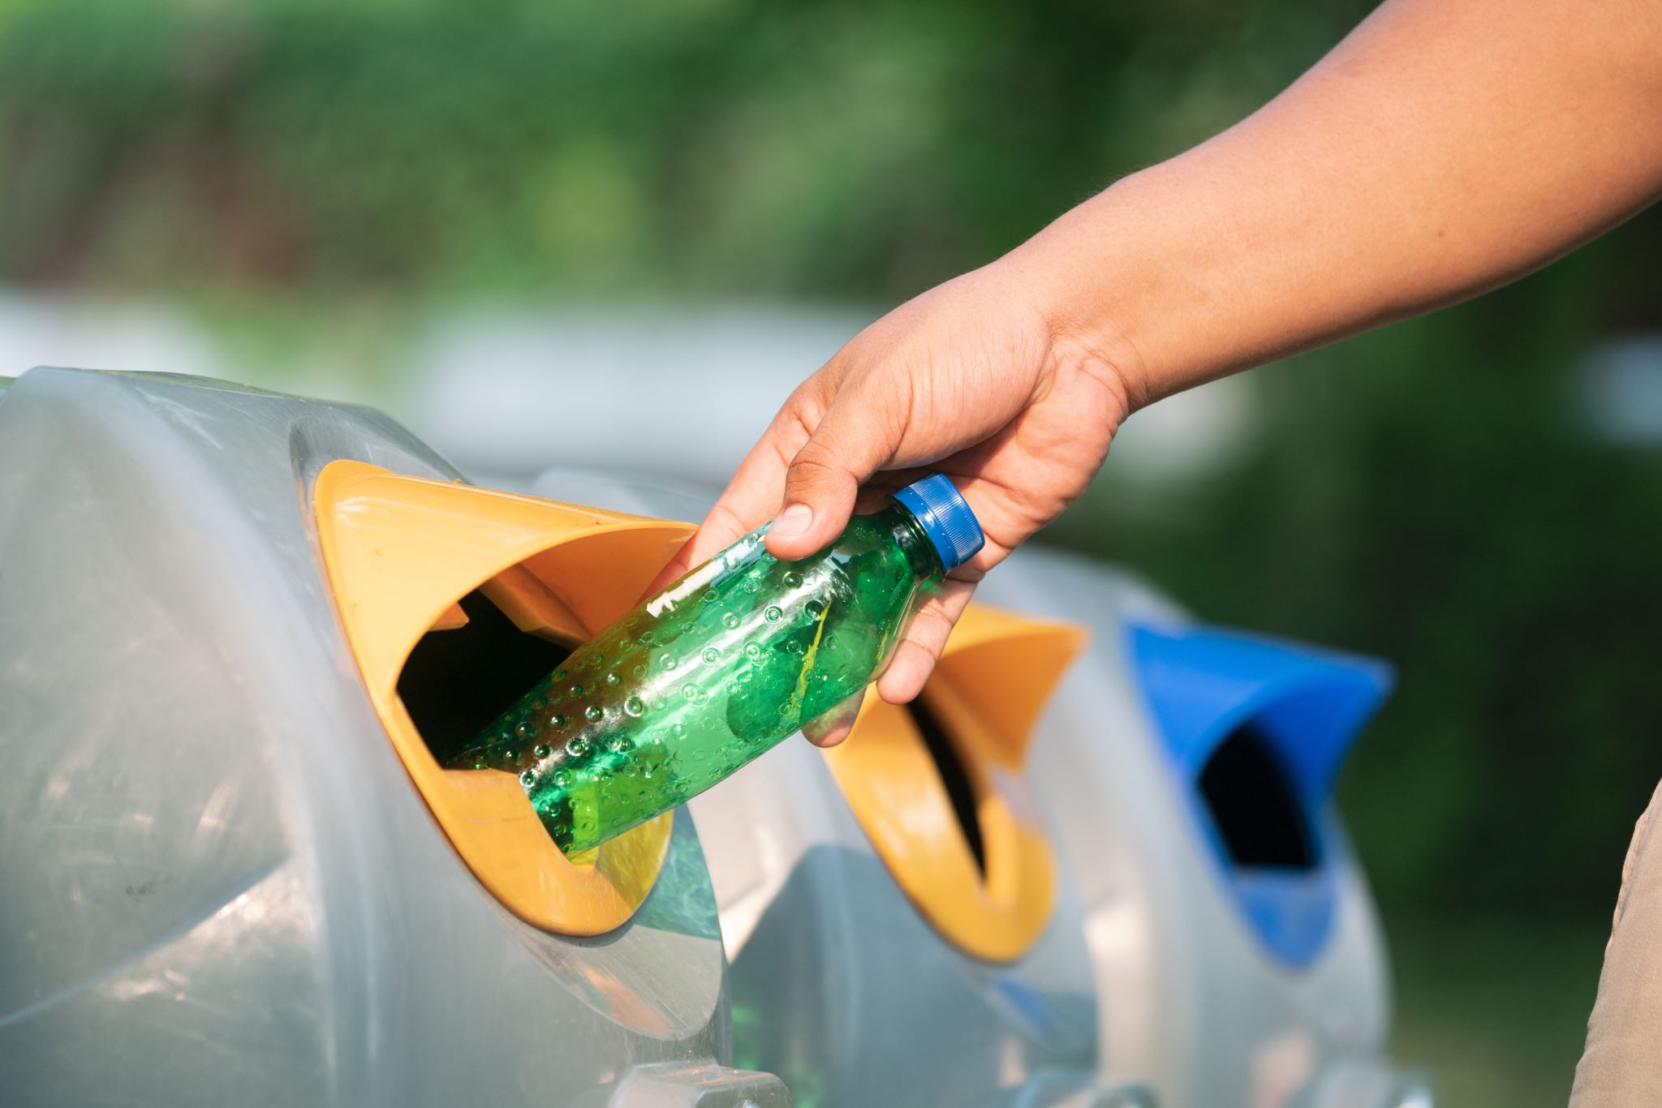
Small actions make big changes.
With your help we can make the world a better place. All you have to do is...
Reduce
Reuse
Recycle

Slide 4
Do you have any ideas on what the super heroes should do?
Should we.....
:leave the litter and hope for the best
:put all the litter in the bin
:get someone else to do it
:teach the animals to pick up
:make the animals eat it

