Slide 1
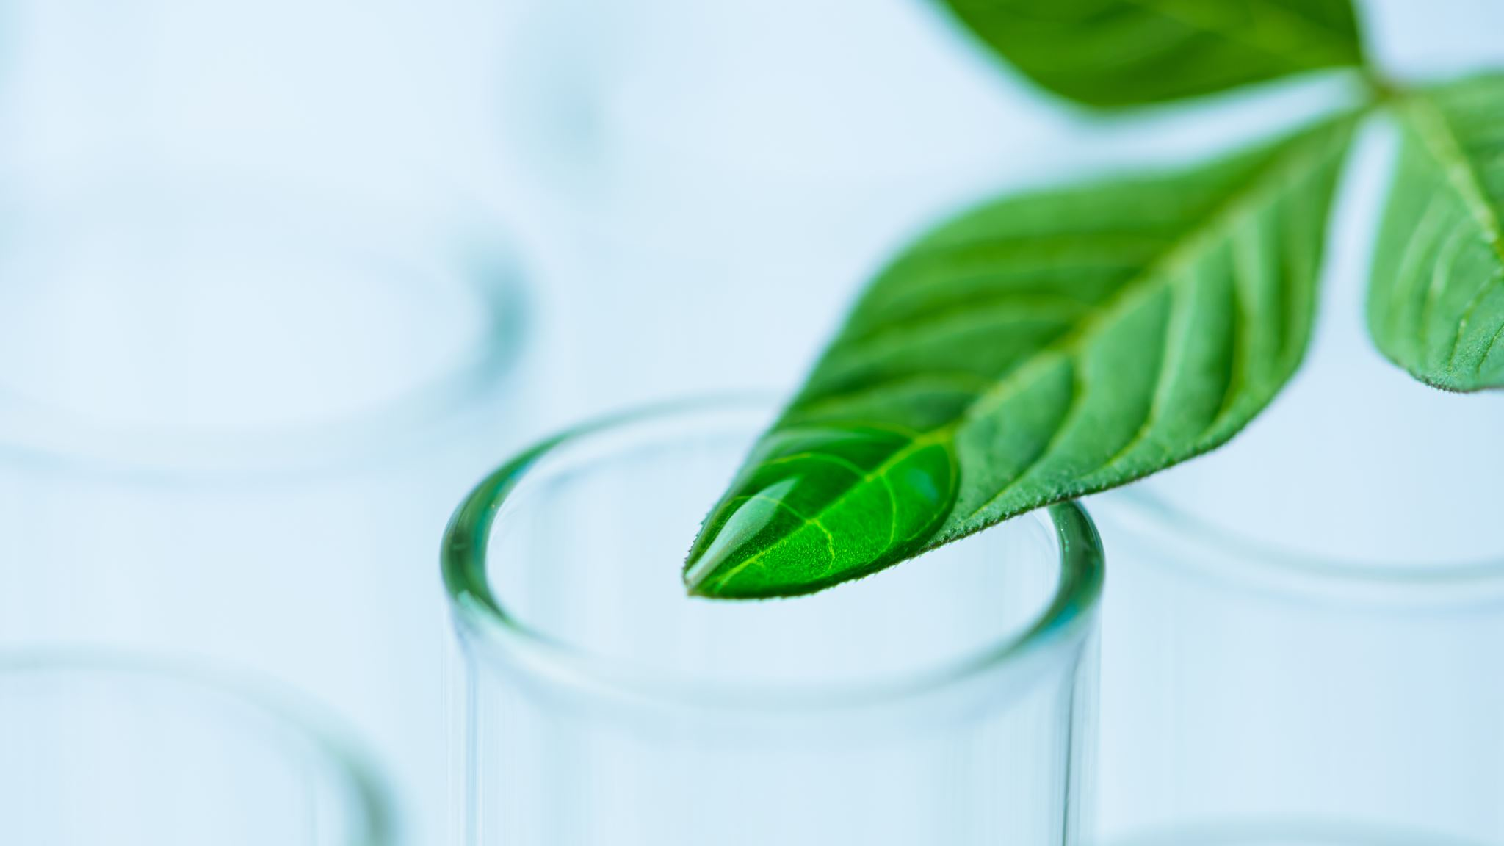
ECO COUNCIL
LITTER HEROES

Slide 2
Litter Heroes
We will now show you a representative story we have made, please listen

Slide 3
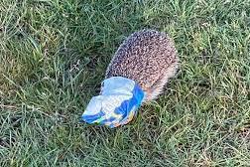
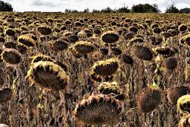
Problems of today
Here we have two pictures of what happens when we litter. animals such as birds, hedgehogs, and rabbits as they can get stuck in packets of crisp, plastic bags and fizzy drink holders could hurt them. So, we've decided to add faces to our bins to show what ones are Recyling and General waste we thought this can help children to put recyclable wrappers in the right bin.
We can also help the planet and all the beautiful plants be healthy by not littering and to keep watering them at least twice a week.

Slide 4

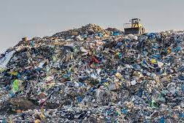
Look first before throwing wrappers away
Look for these symbols on your wrappers to throw them in the right bin. These symbols mean recyclable so you can put them in a recycling bin.
The bottom picture shows what happens to your waste when you put it in the wrong bin. It goes to places like landfills.

Slide 5
THE END
NOW YOU CAN DO IT TOO, WE HOPE YOU CAN DO YOUR PART.

