Slide 1
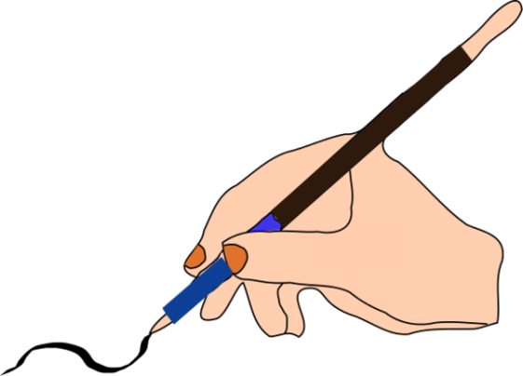
Handwriting
Specific Learning Difficulties
Dysgraphia
Dyspraxia
Developmental Coordination Difficulties
Dyslexia

Slide 2
Handwriting Difficulties
Specific Learning Difficulties
Dysgraphia
Dyspraxia
Developmental Coordination Difficulties
Dyslexia
What are the similarities and differences?
Notes:
Dyslexia – is defined as chronic neurological disorder causing inability or great difficulty in learning to read or spell, despite normal intelligence. It inhibits recognition and processing of graphic symbols, particularly those pertaining to language. Symptoms, including very poor reading skills, reversed word and letter sequences, and illegible handwriting, usually become evident in the early school years. With early recognition and specialised approaches to teaching reading, most dyslexics can learn to read.
Dysgraphia – is a learning disability that affects writing, which requires a complex set of motor and information processing skills. Dysgraphia makes the act of writing difficult. It can lead to problems with spelling, poor handwriting and putting thoughts on paper. People with dysgraphia can have trouble organising letters, numbers and words on a line or page.
Dyspraxia – Developmental dyspraxia is an impairment or immaturity of the organisation of movement. It is an immaturity in the way that the brain processes information, which results in messages not being properly or fully transmitted. The term dyspraxia comes from the word praxis, which means ‘doing, acting’. Dyspraxia affects the planning of what to do and how to do it. It is associated with problems of perception, language and thought, according to the Dyspraxia Foundation. Children that have dyspraxia may suffer from clumsiness, slightly slurred speech, awkwardness with walking or short term memory loss.
Developmental Coordination Difficulties is the term used widely across the world, the UK calls it ‘dyspraxia’. Specialists have determined that it is a delay in the development of the communicative paths for coordination.
The reason they use DCD and not dyspraxia is because dyspraxia is also the term that’s used to describe motor skills difficulties that can occur at any time of life as a result of damage to the brain (e.g. a head injury from an accident, or from suffering a stroke). Whereas DCD is something that our children are born with.
Developmental Dyspraxia has been used as a compromise.
More often, children have co-occurring difficulties with Dyslexia, Dyscalculia, Dysgraphia, Apraxia, ADHD, ASD or ODD.

Slide 3
What is it?
Dyspraxia
An issue that can impact fine and gross motor skills. Trouble with fine motor skills in particular can affect handwriting. Dyspraxia also typically affects a person’s conception of how his body moves in space.
Pupils with dyspraxia can have other learning and attention issues, such as dysgraphia, dyscalculia and ADHD, but dyspraxia isn’t the cause for these.
Dysgraphia
An issue that impacts written language. It can affect both information and motor processing (which can impact handwriting). It can cause trouble with many aspects of writing, usually because of language-based weaknesses.
Pupils with dysgraphia can have other learning issues. The two that co-occur most often with dysgraphia are dyslexia and dyspraxia.

Slide 4
Signs you may notice
Dyspraxia
Trouble riding a bike or throwing a ball
A tendency to bump into and drop things
Delayed development of right or left hand dominance
Trouble grasping a pencil correctly
Poor letter formation
Slow and messy handwriting
Trouble using buttons, poppers, zips, laces and utensils
Dysgraphia
Trouble organising thoughts and putting them into writing
Illegible handwriting
Slow, laboured writing
Odd spacing of words and letters
Poor spelling and grammar
Trouble with grasping a pencil correctly
Poor punctuation skills
Run-on sentences and lack of paragraph breaks

Slide 5
Possible emotional and social impact
Dyspraxia
Pupils with dyspraxia may avoid games and sports that call attention to their physical awkwardness. They may also experience anxiety at a higher rate than other children, for unknown reasons.
Dysgraphia
As can happen with any learning issue, pupils with dysgraphia may feel frustrated or angry about their challenges. They can also have trouble with self-esteem.

Slide 6
What can help
Dyspraxia
Occupational therapy (OT) or physical therapy can strengthen gross and fine motor skills. OT can also help with balance and body awareness.
Therapists can also work on breaking down physical tasks (such as brushing teeth) into smaller steps.
Dysgraphia
Graphic organisers can help pupils organise their thoughts.
Post it Notes
A checklist can make it easier to review and edit written work.
Assistive technology or word processing can make writing easier.
OT can strengthen fine motor skills and support motor coordination.

Slide 7
Strategies
Dyspraxia
Teaching physical skills in small parts before they’re taught to rest of class
Repeating activities to help develop motor pathways, which can help pupils get better at carrying out specific movements
Multisensory instruction to help students remember the steps for motor actions
Use of a keyboard for taking notes in class; use of a word processor in school
Keyboarding instruction
Extended time on tests and assignments that involve writing
Access to another student’s or the teacher’s notes
Option to respond in alternative ways rather than writing
Sentence starters to show how to begin a writing assignment
Breaking writing assignments into steps
Worksheets, notes and textbooks with larger print
Dysgraphia
Option to respond in alternative ways rather than writing
Sentence starters to show how to begin a writing assignment
Breaking writing assignments into steps
Use of a keyboard for taking notes in class; use of a word processor in school
Keyboarding instruction
Extended time on tests and assignments that involve writing
Access to another student’s or the teacher’s notes
Permission to record class lectures

Slide 8
What you can do at home
Dyspraxia
Provide lots of opportunities for physical activity like running or swimming to develop gross motor skills, muscle strength, coordination and “muscle memory.” (You can even turn your living room into an obstacle course using pillows or wastebaskets to help with motor planning.)
Have your child play with jigsaw puzzles to help with visual and spatial perception.
Toss beanbags and balls to practice hand-eye coordination.
Have your child work on keyboarding skills.
Use speech-to-text tools to translate your child’s speech into writing.
Provide many opportunities for practice and repetition.
Dysgraphia
Have your child work on keyboarding skills.
Use speech-to-text tools to translate your child’s speech into writing.
Use clay, shaving cream and other materials to practice forming letters at home.
Have your child shake or rub his hands to relieve tension before writing or as a break while writing.

Slide 9
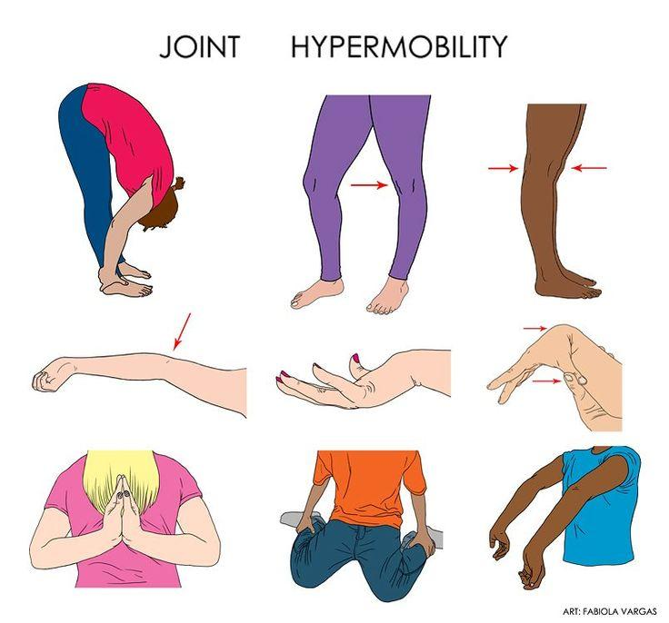
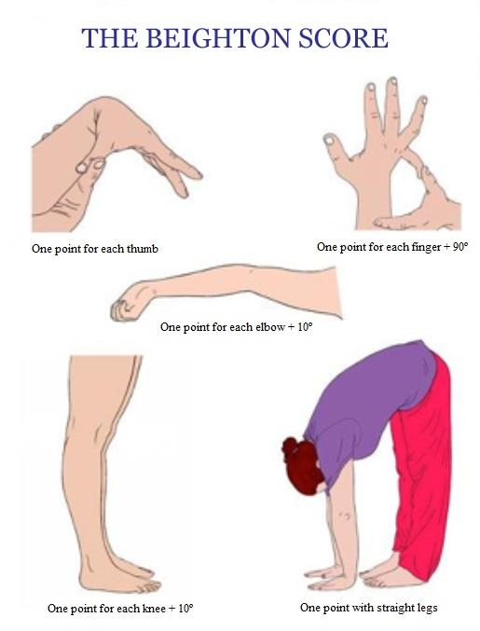
Hyper-mobility
Hyper-mobility syndrome is a condition that features joints that easily move beyond the normal range expected for that particular joint. Hyper-mobile joints tend to be inherited. Symptoms of the joint hyper-mobility syndrome include pain in the knees, fingers, hips, and elbows.
Notes:
Ehlers Danlos Syndrome is a severe version of hyper-mobility where the joints have trouble staying place due to very stretchy ligaments

Slide 10
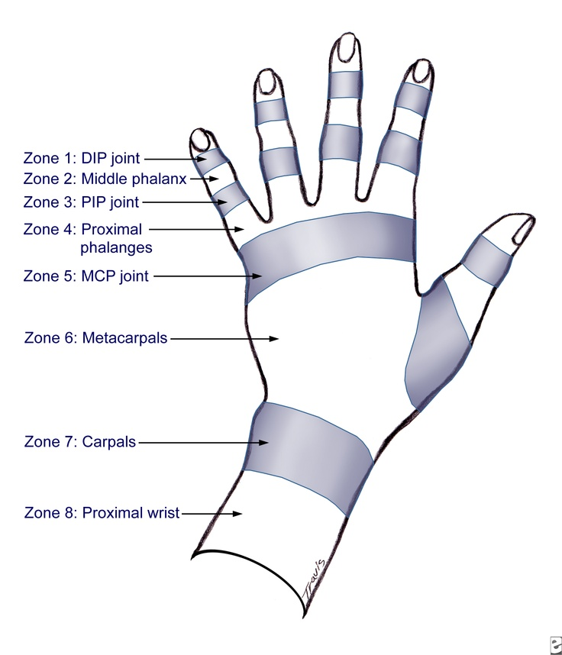
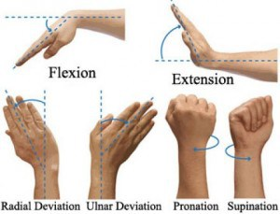
Know your Tools
Notes:
DIP = Distal Interphalangeal
MIP = Middle
PIP = Proximal
MCP = Metacarpo-phalangeal
Heel of the hand is called the Thenar or Thenar Eminence
The fleshy bit on the outer side is called the Hypothenar or Hypothenar Eminence

Slide 11
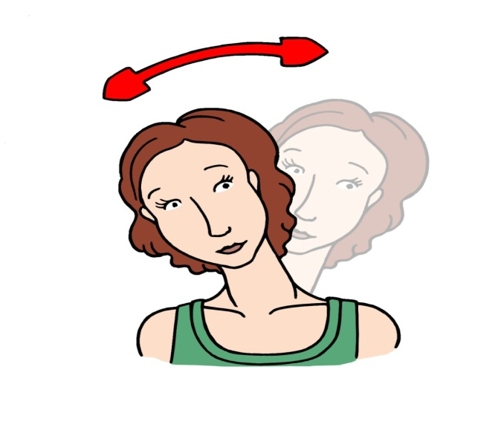
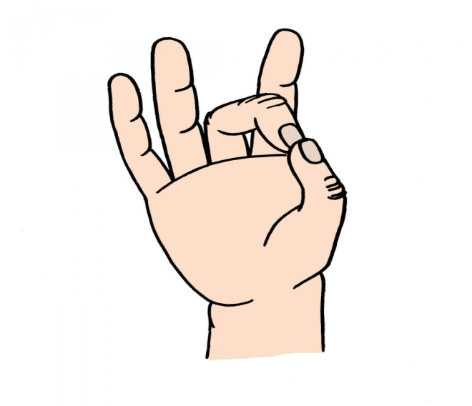
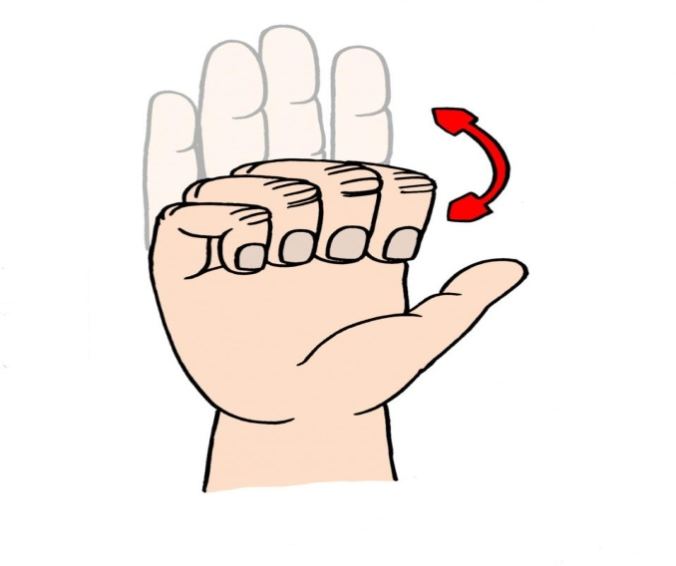
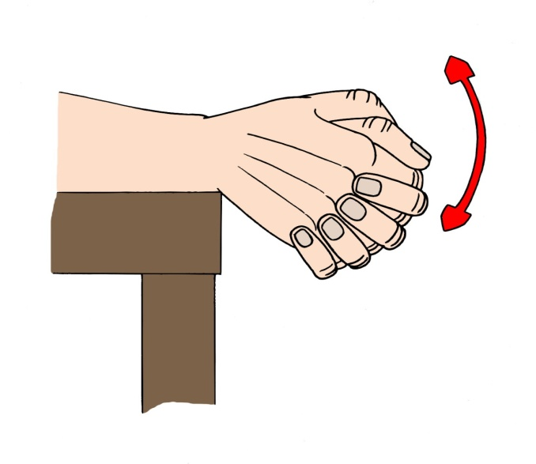
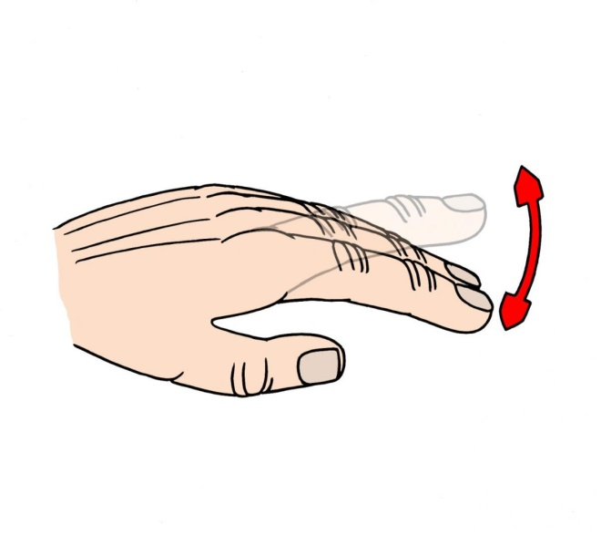
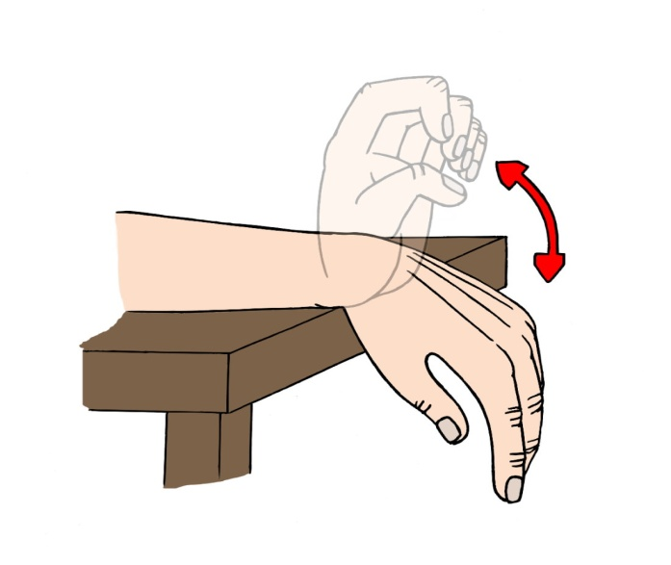
Warm-up Activities

Slide 12
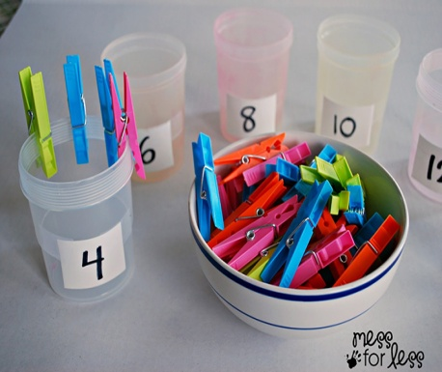
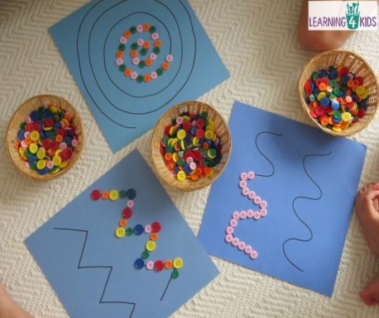

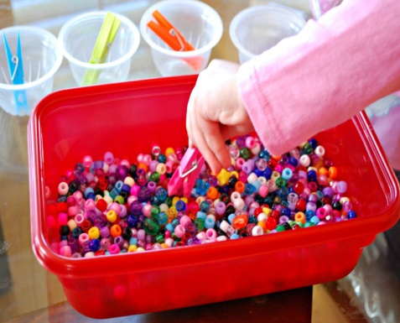

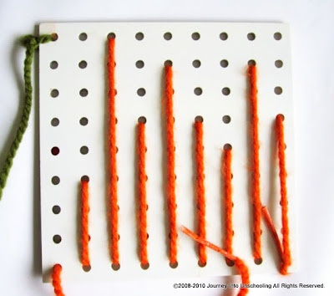
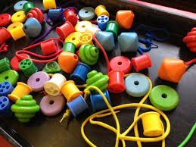

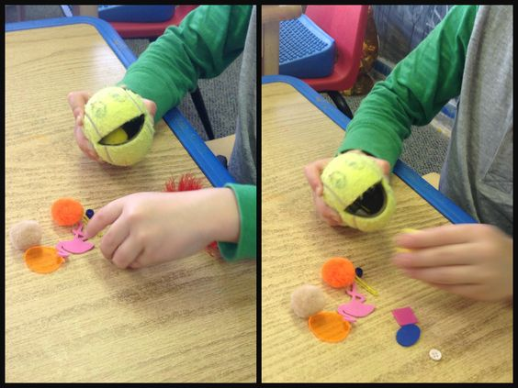

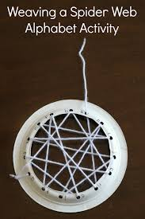
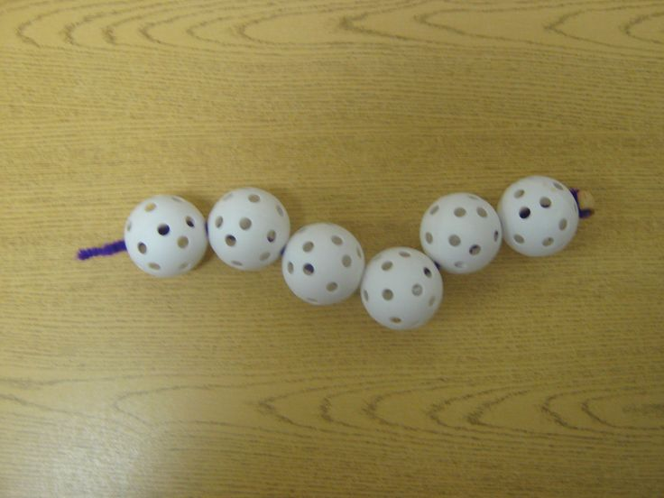
Fine Motor Activities
Notes:
Many different types of tweezers
Play Doh
Elastic bands
Cutting out shapes
Pegs
Paperclips
Sponge balls
Nuts and bolts

Slide 13
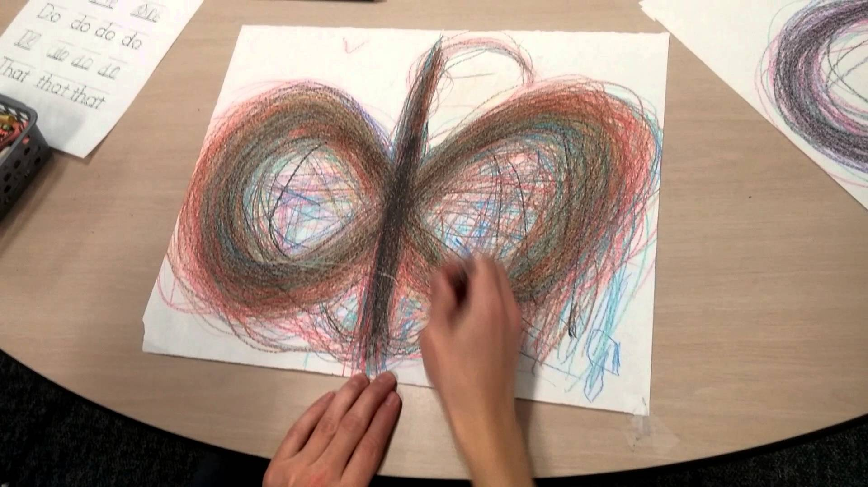
Lazy 8

Slide 14
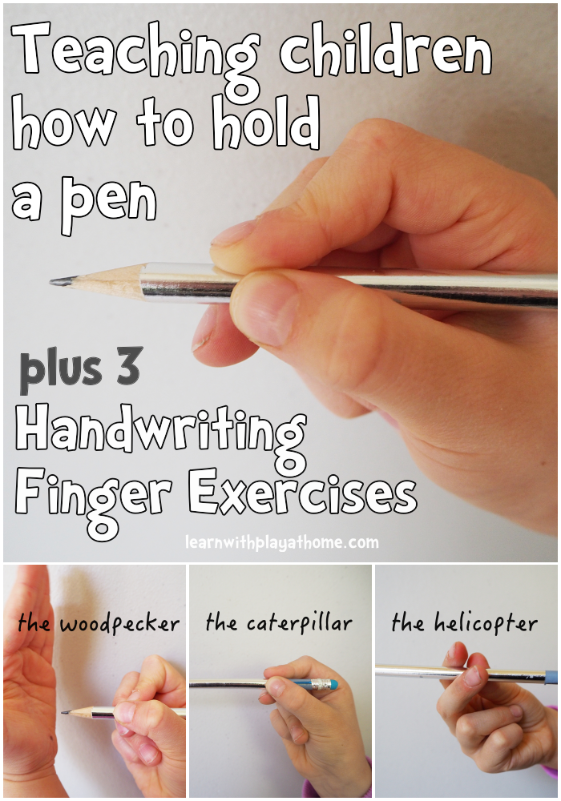
Nearly there…

Slide 15
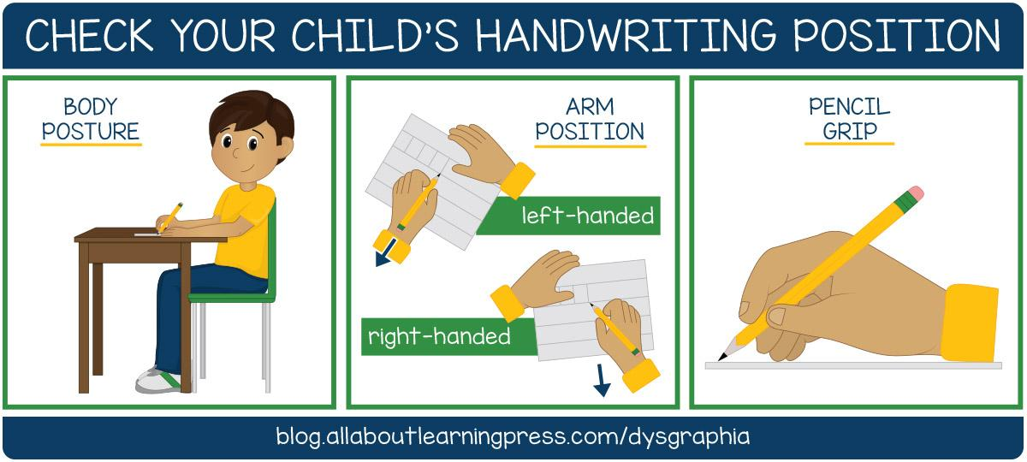
Are you sitting comfortably?

Slide 16
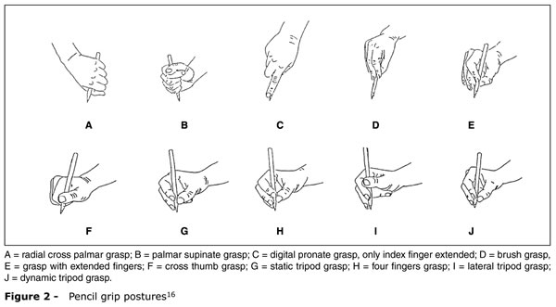
Handwriting Grasps

Slide 17
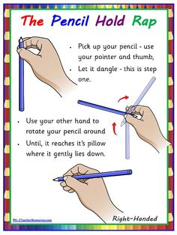
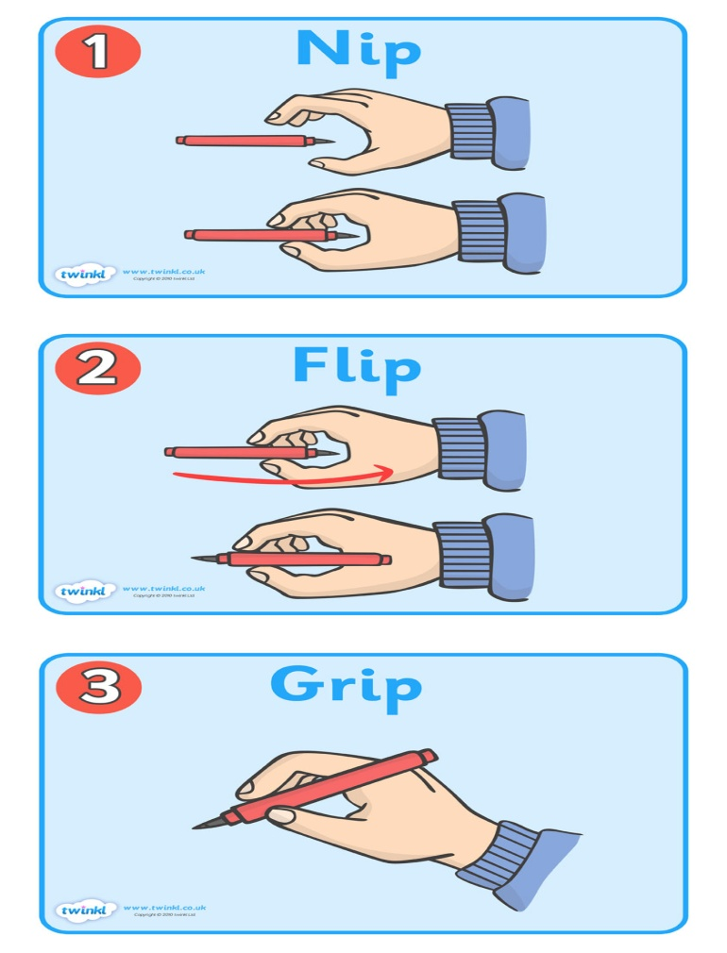
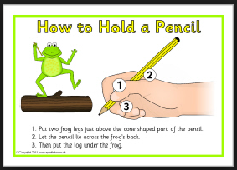
The Dynamic Tripod Grasp

Slide 18
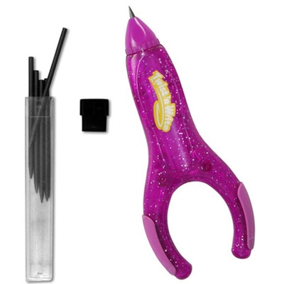
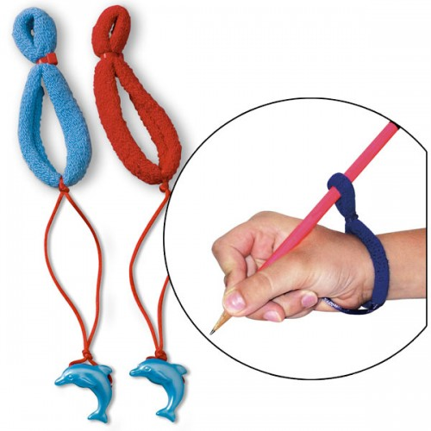
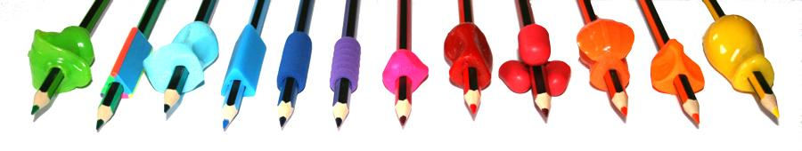
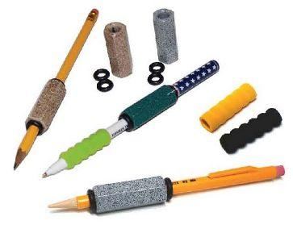

Handwriting Tools

Slide 19
Yes
From Reception age
We cannot rely on parents to teach their child how to hold a pencil or use a knife and fork or even instruct them on how to clean their teeth or tie shoelaces.

Slide 20
Your Turn
Stick letters – iltuyj
Up, down over the hill letters – nhmbpr
2 O’clock letters – acgqdseo
Angular letters – vwxz
Kick and flick letters – kf(jz)
Tail letters – yjqpgfn(z)
Capital letters
Numbers

Slide 21
As a scheme of work
Day 1: ‘i’ drawn large, then smaller, then smaller and smaller still. Create a line of individual ‘i’s and then a line of joined up ‘i’s.
Day 2 -6: each day will have will practise the next letter in the same way as day one but you will add on the next letter to create a pattern e.g. il, ilt, iltu, iltuy, iltuyj
Day 7: words containing the letters used so far: jut, lit, till, lilt etc.
Day 8 start ‘Up, down over the hill letters,’ one at a time and so on…..

Slide 22
After the letters
Once all of the letters have been learned, we then move onto learning the weekly spellings.
For right handed people the prompt word should be written on the left hand side of the page; for a left handed person it needs to be written on the left hand side.
Assessment pieces should be carried out one a small term by copying a poem or short prose to monitor progress.

Slide 23
To Conclude…
Specific learning difficulties can impact on a child’s handwriting and where this is the case; find out whether or not they are in pain when writing. If so, try to find other ways of recording that child’s knowledge and understanding – photos, charts, drawings, typing, recordings, power points, teach note taking and the use of graphic organisers.
Dyspraxic children need to develop muscle memory so repetition in a comfortable position is key, little and often.
For everyone else, it is a case of practice and not seeing it as a separate skill; carrying it through all written tasks and having it modelled by the staff.

Slide 24
Useful Addresses
https://www.understood.org/en
blog.allaboutlearningpress.com/dysgraphia
http://dyspraxiafoundation.org.uk/about-dyspraxia/
http://www.nhs.uk/Conditions/Dyspraxia-(childhood)/Pages/Introduction.aspx
http://www.cambridge.org/penpals
http://www.nha-handwriting.org.uk/NHA/media/Public/Downloads/Fully-cursive-writing-in-Reception.pdf
http://www.education-show.com/files/day_2_wakefield___r_hudaks2_handwriting.pdf
http://www.teachhandwriting.co.uk/handwriting-warm-up-exercises.html
http://handwriting-solutions.com/dysgraphia.asp
https://www.handwritingworksheets.com/
http://www.sassoonfont.co.uk/fonts/sas/pri_lit_dev_wrtng_005501.pdf
http://www.foundationyears.org.uk/wp-content/uploads/2011/11/Gateway-to-Writing-Developing-handwriting.pdf

