Slide 1
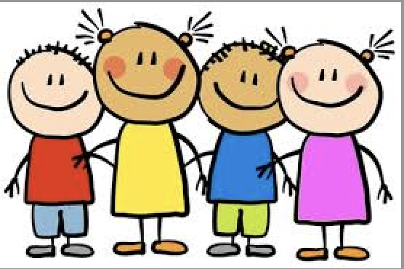
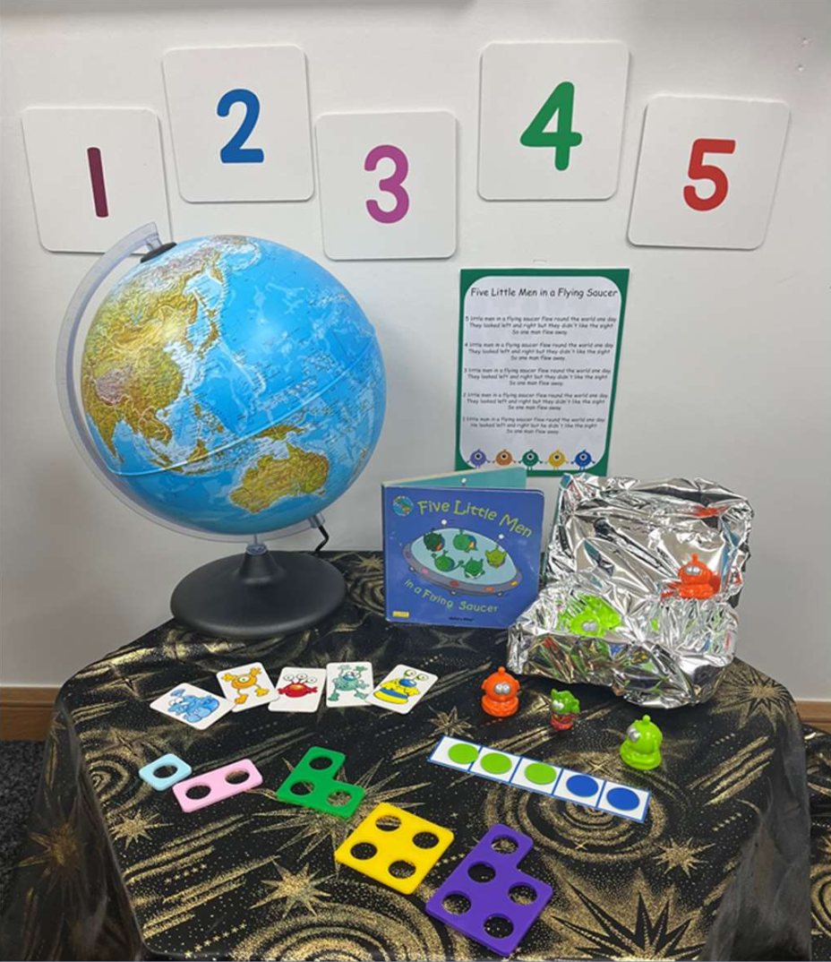
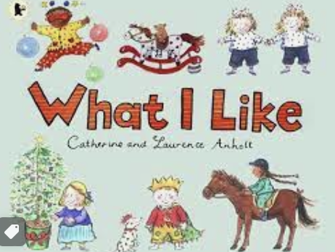
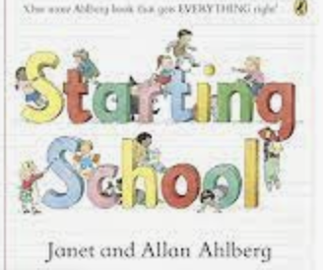
Autumn Term 2026 - Curriculum bulletin
Year EYFS – All About Me
Mathematics
English
For Mathematics this term, the children will be learning to identify, count and represent numbers to 5. They will be introduced to the vocabulary more and less and will be able to say what is one more and one less than any number to 5. They will practice subitizing with groups of up to 5 objects and explore composition of numbers to 5. The children will also explore shape, by learning about triangles, circles, squares and rectangles.
The children will also practice making and continuing different patterns as well as using comparative language to describe size. We will explore positional language including words such as forwards, backwards, in front of etc.
The children will be introduced to these concepts through stories, rhymes and role-playing opportunities, concrete manipulatives and games.
Reading:
This term, the children will be focusing on developing their knowledge of the sounds that make up words through our phonics programme ’Read, Write, Inc.’ They will learn all set 1 sounds and practice reading and sounding out words that contain these sounds.
Once the children can demonstrate they they have a good understanding of the sounds, and are beginning to blend to read words, they will start to bring books to read at home.
The children will also be reading lots of stories in class, linked to their topic ‘All About Me’ including: ‘The Growing Story’, ‘Once There Were Giants’ and ‘The Invisible String’.
Writing:
Inspired by the book ‘what I like’ the children will be writing their own books and stories all about them. They will learn how to use mark making, drawings and writing to teach other people in school about them.

Slide 2

The Big Picture – All About Me!
Autumn Term 2024 - Curriculum bulletin
Communication and Language
Personal, Social and Emotional Development
This term, the children will be developing their communication and language skills by learning to share their likes, dislikes and things that are special to them with their new friends. They will be encouraged to initiate conversation with the peers and take in an interest in what others say.
There will be lots of opportunities for the children to learn and re-tell stories and rhymes. They will also take part in circle times and games as they get to know each other and develop confidence.
For personal, social and emotional development. The children will be learning all of the new rules and routines of the classroom. They will learn about the ways that they can make good choices in school and why it is important that we all follow the school rules.
The children will also be developing a sense of identity as they think about their likes and dislikes and the people that are special to them. They will learn to understand that they are important to us as they belong to our school community and other communities they belong to, such as their family.
Physical Development
For physical development, the children will learn to move safely in a space. They will develop control when using equipment around the school. The children will learn to follow a path and take turns and how to work co- operatively with a partner.
The children will also practice how to balance,
Jump and hop and to explore different ways to travel using equipment.
For fine motor development, the children will be using a range of fine-motor manipulatives to develop finger strength. They will learn how to warm up their fingers before drawing and writing to develop fine-motor control.

Slide 3
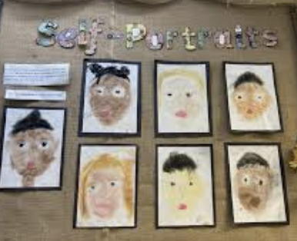
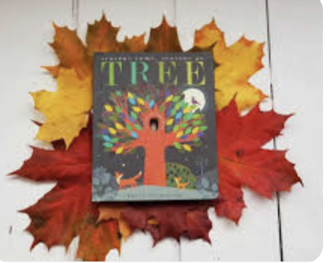
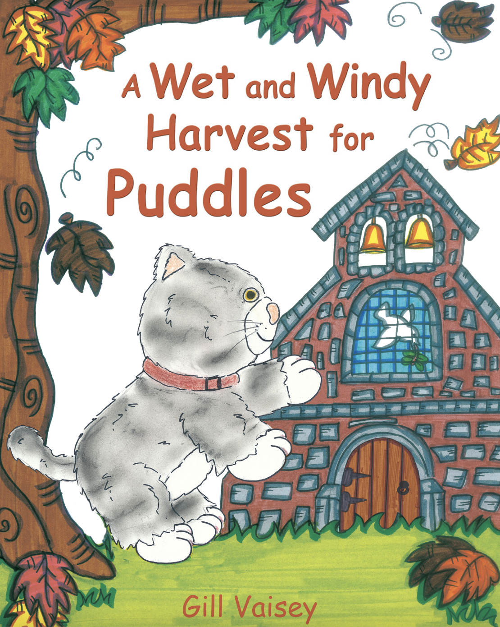

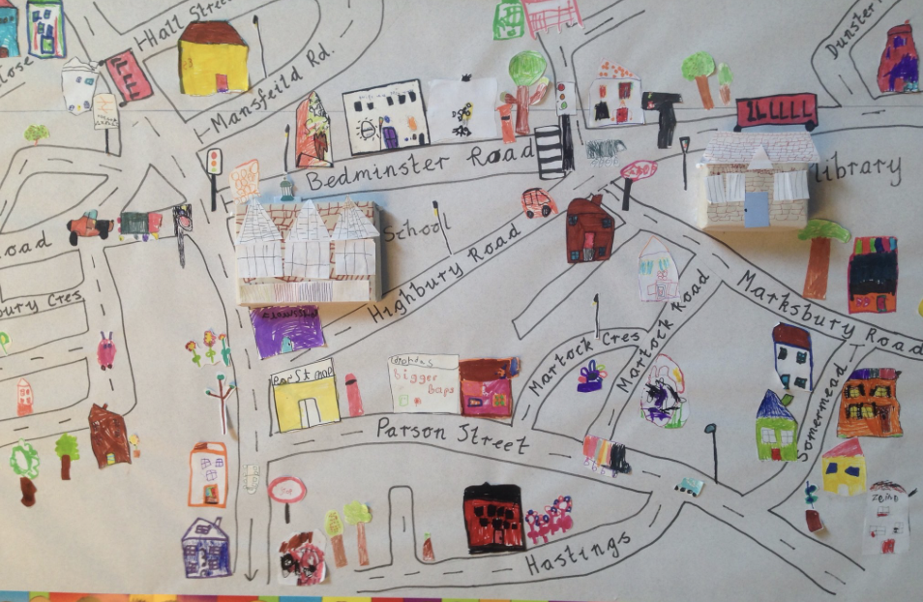
Autumn Term 2024 - Curriculum bulletin
Understanding the World
For understanding the world, the children will be looking back at how they have changed since they were born. They will sequence photos of themselves and talk about all of the things they have learnt to do, and what they would like to learn to do in the future. They will repeat this activity in the spring term to see how they have changed, and what they have learnt to do since their first day of school!
The children will learn about the 5 senses, as they discuss their likes and dislikes such as foods and smells. The children will also be learning about seasonal changes as they observe the changes they can see during the Autumn term.
For technology, the children will use the cameras to take pictures of the special people in our school.
Expressive Arts and Design
For creative design, the children will design and make their own treasure boxes to hold their own treasured items such as photographs of family and favourite toys.
The children will also learn how to paint a self-portrait. They will look closely at themselves in a mirror and learn some simple colour mixing to create a likeness of themselves.
RE
The children will be introduced to the Christian faith through 'The Puddles’ series of books. In these stories, the children hear about the adventures of puddles (a very mischievous cat) to find out about different aspects of the Christian faith.
This term, the children will find out about harvest service and St. Francis service through the stories ‘A wet and windy Harvest for Puddles.’ and ‘The St Francis Service’.
Trips and enrichment
This term, the children will take part in local walks around their school, and the wider village. They will take photographs on their journey to explore all of the places that make up our local community. The children will be learning to make maps of their school, and local community.

Slide 4
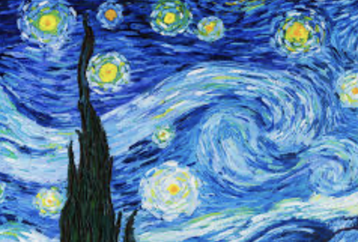
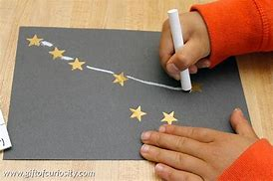
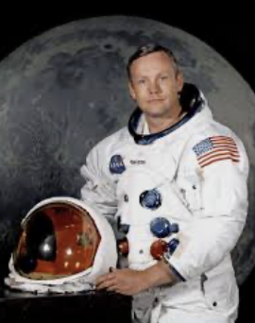
The Big Picture – Starry Night
Autumn Term 2024 - Curriculum bulletin
Expressive Arts and Design
For expressive arts and design, the children will explore the painting ‘Starry night’ by Vincent Van Gough.
They will be painting their own starry night pictures inspired by the painting.
.
Understanding the World
For understanding the world, the children will learn that the sun and the stars make their own light. They will be asked to think about whether the moon makes its own light and learn about the concept of reflection. They will sort objects such as: sun, stars, fire, light bulb, foil, mirror, metal, moon et. into those that make their own light and those that reflect light. They will use mirrors and torches to explore reflection.
The children will also look at the names of the planets in our solar system and talk about what the planets are like. They will compare the size of the different planets and think about what the planets are made from. Listen to the planet songs.
To develop their understanding of past and present, the children will learn about the significant event of ‘The Moon Landing’ in 1969. They will talk about the moon and what it is like and that it is very far away. They will consider how a person might be able to travel to the moon and will learn that Neil Armstrong was the first man to ever step on the moon.
They will think about how Neil Armstrong might have felt and what he was wearing on his visit to the moon.
The children will also look at images of the night sky and talk about how the stars look. They will learn that sometimes the stars look like they are scattered in the sky and sometimes they look like they are arranged into a shape called a constellation. The children will create their own constellation pictures.

Slide 5
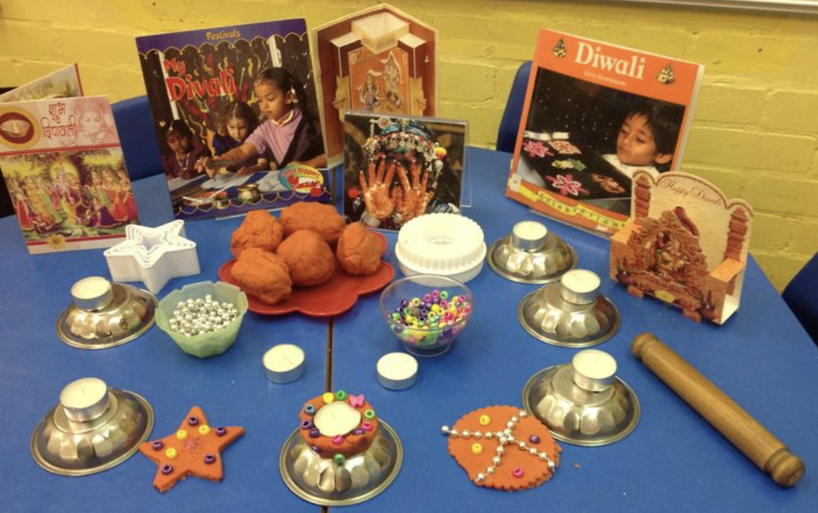
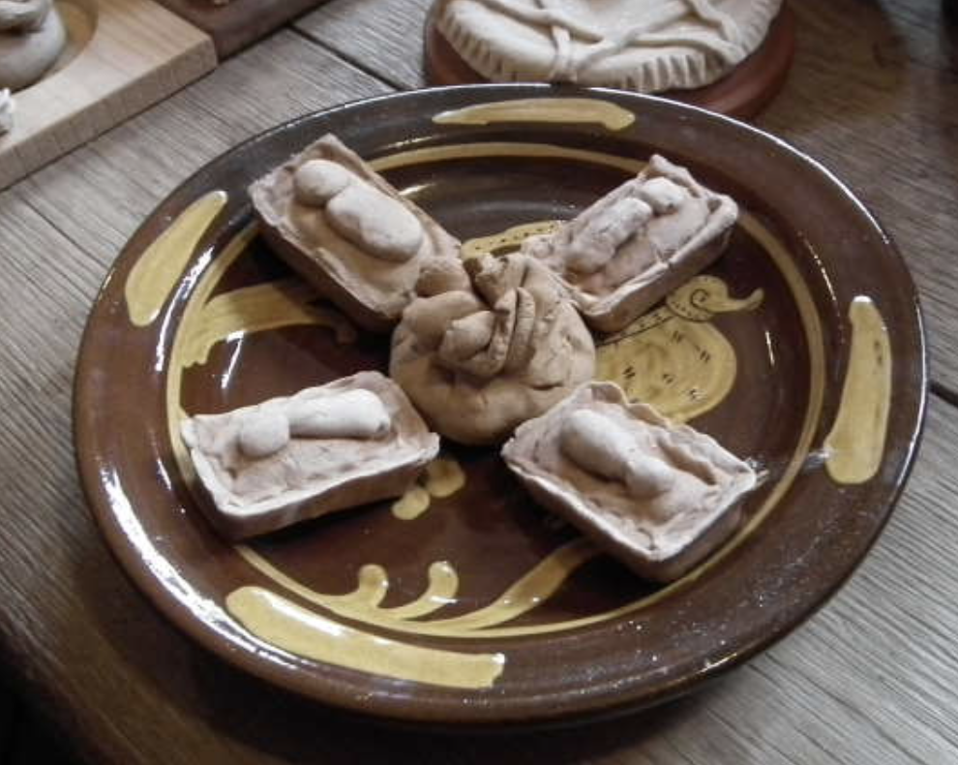
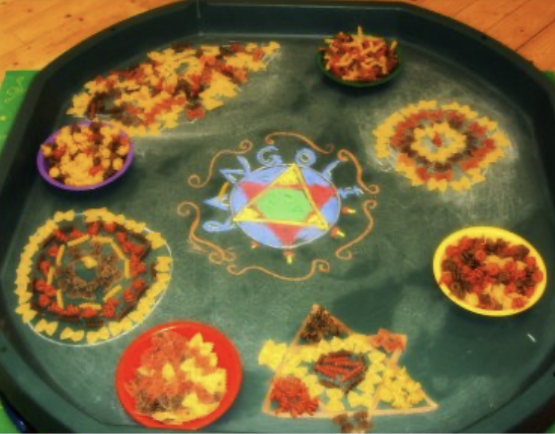
The Big Picture – Star in a Jar
Autumn Term 2024 - Curriculum bulletin
Cultural Celebration
Christmas
This term, the children will also be learning about Diwali. They will learn that Diwali celebrated by Hindus, which is a religion like Christianity is, and that Hindus go to special temples to worship their deities. These deities include, Vishnu, Lakshmi, Shiva, Parvati, Brahma and Saraswathi.
Hindus also believe in one God but pray to the different deities for different things.
They will learn that Hindus worship is through singing and will learn a song about Diwali.
The children will prepare for their own Diwali celebration by creating Rangoli patterns.
Towards the end of term, the children will learn about Christmas. They will talk about advent and learn what advent means. They will read the story about the first Christmas and that this is about celebrating baby Jesus being born. They will also learn about how Christmas is celebrated in different countries including decorating houses, buying gifts and making special food.
They will learn that mince pies are a favourite food to make and eat at Christmas time and how they were originally oblong shaped to represent the manger with a pastry baby Jesus carved into the pastry. The children will make their own mince pies.
The children will also learn Christmas songs and carols to perform in a Christmas Sing-a-long to celebrate the end of term.

