Slide 1





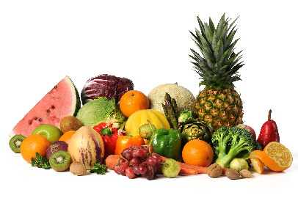

MENU 01:
Served weeks commencing 01st Sept, 21st Sept, 12th Oct, 02nd Nov, 23rd Nov, 14th Dec
Vegetarian Halal
Monday | Tuesday | Wednesday | Thursday | Friday
Jacket Potato with Filling | Chilli con Carne or Chicken Curry | Roast Chicken or Roast Pork | BBQ Chicken Pizza | Oven Baked Fish Fingers
Macaroni Cheese | Chickpea and Lentil Korma | Quorn Roast | Margarita Pizza | Vegetable Burger
Baked Beans | Brown Rice | Roast Potato |  | Potato Waffles
Cheese/Tuna/Coleslaw Salad Bar Wholemeal Rolls | Peas Salad Bar Wraps | Mixed Vegetables Salad Bar Wholemeal Rolls | Sweetcorn Salad Bar Garlic Bread | Baked Beans Salad Bar Sliced Bread
Fresh Fruit | Blueberry Muffins | Vegan Raspberry Jelly | Mixed Yoghurts | Vanilla Ice-Cream
All menu items are subject to availability
Do you think you are Free School Meal eligible?
Please contact your school office for more information on how to apply.

Slide 2





MENU 02:
Served weeks commencing 07th Sept, 28th Sept, 19th Oct, 09th Nov, 30th Nov
Vegetarian Halal
Monday | Tuesday | Wednesday | Thursday | Friday
Jacket Potato with Fillings | Beef Lasagne | Roast Chicken or Roast Beef | BBQ Chicken Pizza | Oven Baked Breaded Fish
Cheese and Tomato Tricolour Fusilli Pasta Bake | Vegetable Hot Pot | Vegan Mini Fillets | Margarita Pizza | Vegan Vegetable Sausages
Baked Beans |  | New Potatoes |  | Oven Chips
Cheese/Tuna/Coleslaw Salad Bar Wholemeal Rolls | Cauliflower & Broccoli Salad Bar Garlic Bread | Carrots Salad Bar Wholemeal Rolls | Sweetcorn Salad Bar Garlic Bread | Spaghetti Hoops Salad Bar Sliced Bread
Fruit Loaf Soreen | Peach Slices | Vegan Strawberry Jelly | Mixed Yoghurts | Sliced Oranges
All Menu items are subject to availability
Do you think you are Free School Meal eligible?
Please contact your school office for more information on how to apply.

Slide 3


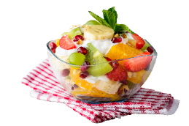


MENU 03:
Served weeks commencing 14th Sept, 05th Oct, 26th Oct, 16th Nov, 07th Dec
Vegetarian Halal
Monday | Tuesday | Wednesday | Thursday | Friday
Jacket Potato With Filling | Chicken Korma Curry Or Beef Chilli | Chicken Sausages or Pork Sausages | BBQ Chicken Pizza | Oven Baked Fish Cakes with Tomato Ketchup
Tomato Tuna Pasta Bake | Bean & Roasted Vegetable Tacos | Vegetables Meatballs in Gravy | Margarita Pizza | Vegetable Samosas
Baked Beans | Rainbow Rice | Mashed Potato |  | Jacket Wedges
Cheese/Tuna/Coleslaw Salad Bar Wholemeal Rolls | Carrots Salad Bar Chapatti Bread | Mixed Vegetables Salad Bar Wholemeal Rolls | Sweetcorn Salad Bar Garlic Bread | Peas Salad Bar Sliced Bread
Fruit Loaf Soreen | Strawberry Mousse | Vegan Orange Jelly | Mixed Yoghurts | Carrot Cake
All Menu items are subject to availability
Do you think you are Free School Meal eligible?
Please contact your school office for more information on how to apply.

